Slide 1
Three-component spatial autocorrelation processing using SeisImager modules
Processing ambient noise data obtained by Atom 3C and/or MT-Neo.
SeisImager/SW3C license is required.
Download the latest installer from : http://seisimager.com/download/SeisImager.zip
Y(NS)
X(EW)

Slide 2
Outline of three-component (3C) measurement and processing
3C measurement
3C ambient noise data
3C spatial autocorrelation
Rayleigh and Love wave dispersion curves
S-wave velocity model
X(EW)
Radial
Z(UD)
Love
Y(NS)
Y(NS)
Transverse
Z(UD)
X(EW)
Vertical
Rayleigh
Vertical component provides vertical component SPAC. Horizontal components (X and Y) provide radial and transverse component SPACs.
Vertical component SPAC provides a Rayleigh dispersion curve. Horizontal components (radial and transverse) provide a Love dispersion curve using Rayleigh dispersion curve.
3C measurement provides 3C ambient noise data.
Joint inversion of Rayleigh and Love dispersion curves provide an S-wave velocity model.

Slide 3
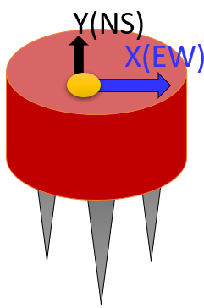
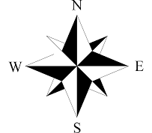
3C ambient noise measurements for SPAC
Triangular array (T4)
L-shaped array (L3)
Arrange the orientation of all sensors to be the same direction

Slide 4
Spatial autocorrelation for 3C ambient noise
Direction of horizontal components must be consistent throughout all sensors and kept track.
Radial and transverse components are defined for each receiver pair.
Transverse component
Y(NS)
component
Rotate horizontal components (X and Y) to radial and transpose components
Transverse component
Radial component
Y(NS)
component
X(EW)
component
Radial component
X(EW)
component
A function calculating transpose and radial components of SPAC from 3C ambient noise data was implemented in SPACPlus and dPickwin.

Slide 5
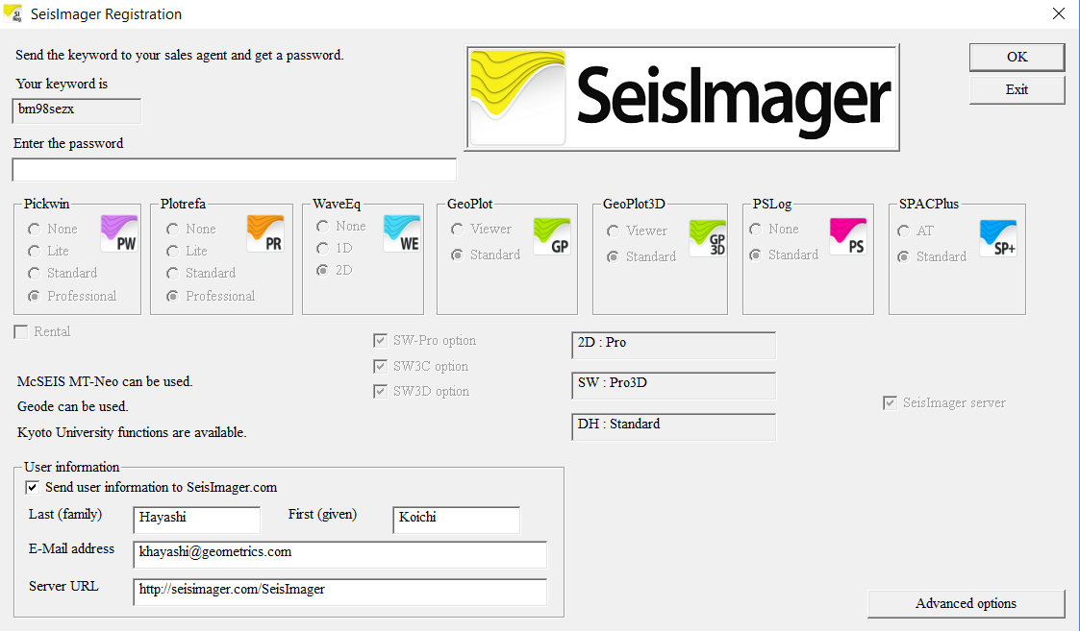
SW3C option in SeisImager
“SW3C option” should be checked in SeisImagerRegistarioan to use 3C processing functions or joint inversion of Rayleigh and Love waves.

Slide 6
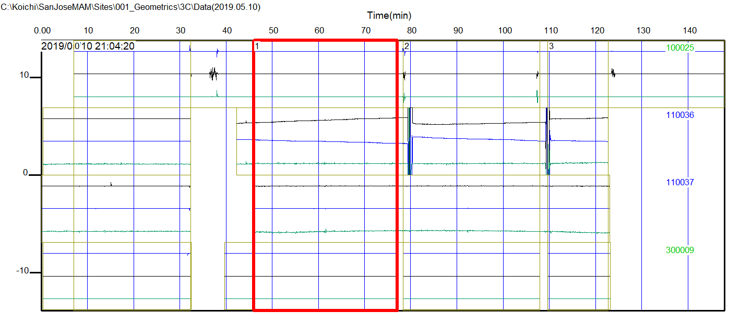
Select a CTB including 3C ambient noise data
Example of three component data

Slide 7
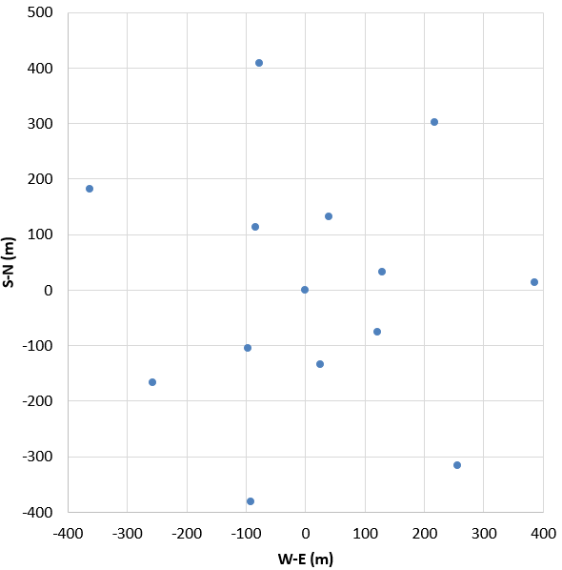
Data example (3C measurements using 14 sensors)
Easting [m] | Northing [m]
0 | 0
217.34 | 302.07
386.02 | 14.16
-257.41 | -166.41
-362.36 | 182.01
-77.33 | 408.01
120.86 | -76.71
129.83 | 31.65
-96.66 | -105.19
38.67 | 132.35
-83.89 | 112.35
256.12 | -315.96
-91.77 | -381.87
25.57 | -134.09

Slide 8
3C SPAC processing flow using SPACPlus, Pickwin and WaveEq
SPACPlus
Pickwin
WaveEq
SPAC (vertical)
SEG2 file (.coh)
Rayleigh phase velocity image
Rayleigh dispersion curve
3C CTB
SPAC (radial)
SEG2 file (.coh)
3C SPAC
Love phase velocity image
Love dispersion curve
SPAC (transverse)
SEG2 file (.coh)

Slide 9
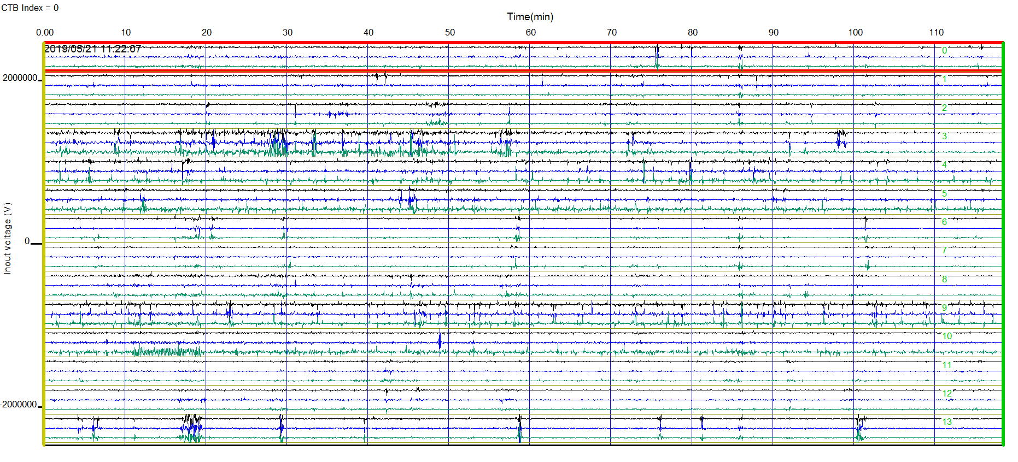
CTB including 3C ambient noise data by 14 sensors

Slide 10
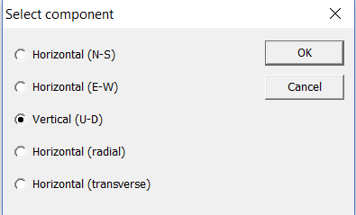
Calculate SPAC for each component
Click to calculate SPAC
Select array geometry. Click “Open array file” if manual array file will be used.
Select a component to be calculated (selecting vertical component)
Select “Manual array” if manual array will be used.
Click “OK” to calculate SPAC.

Slide 11
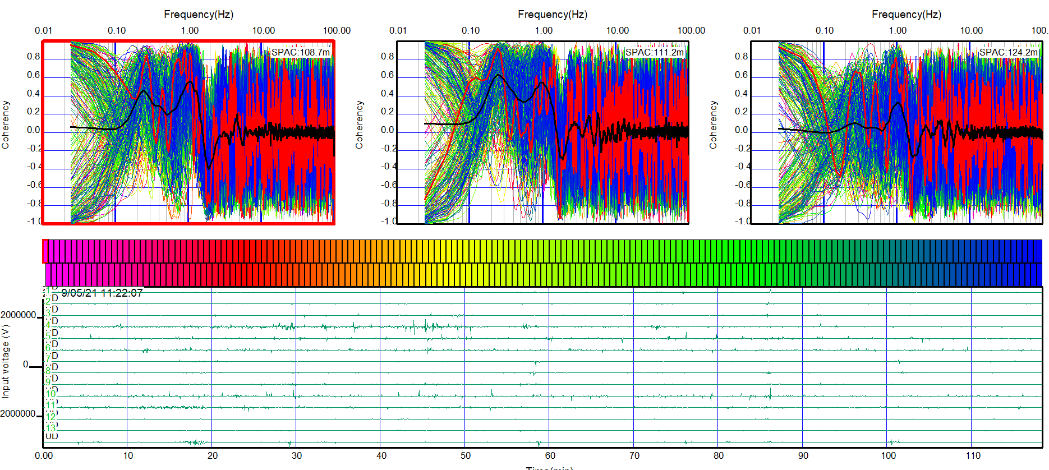
Individual SPAC for each receiver spacing

Slide 12
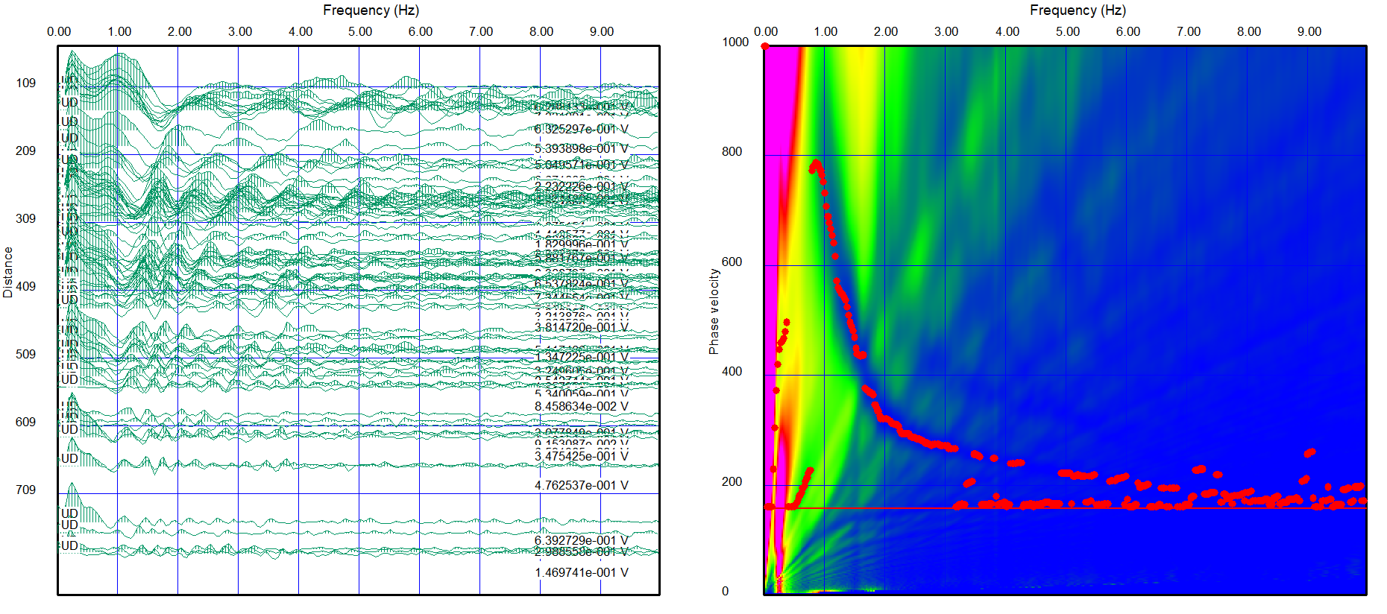
Calculate dispersion curve for each component
Click to calculate dispersion curve
Vertical component
Dispersion curve from vertical component corresponds to Rayleigh wave dispersion curve.

Slide 13
Save coherencies of each component to a SEG2 file
Select “File”, “Save SPAC data as SEG2 file” to coherencies to a SEG2 file.
Use extension “.coh” to save coherencies.

Slide 14
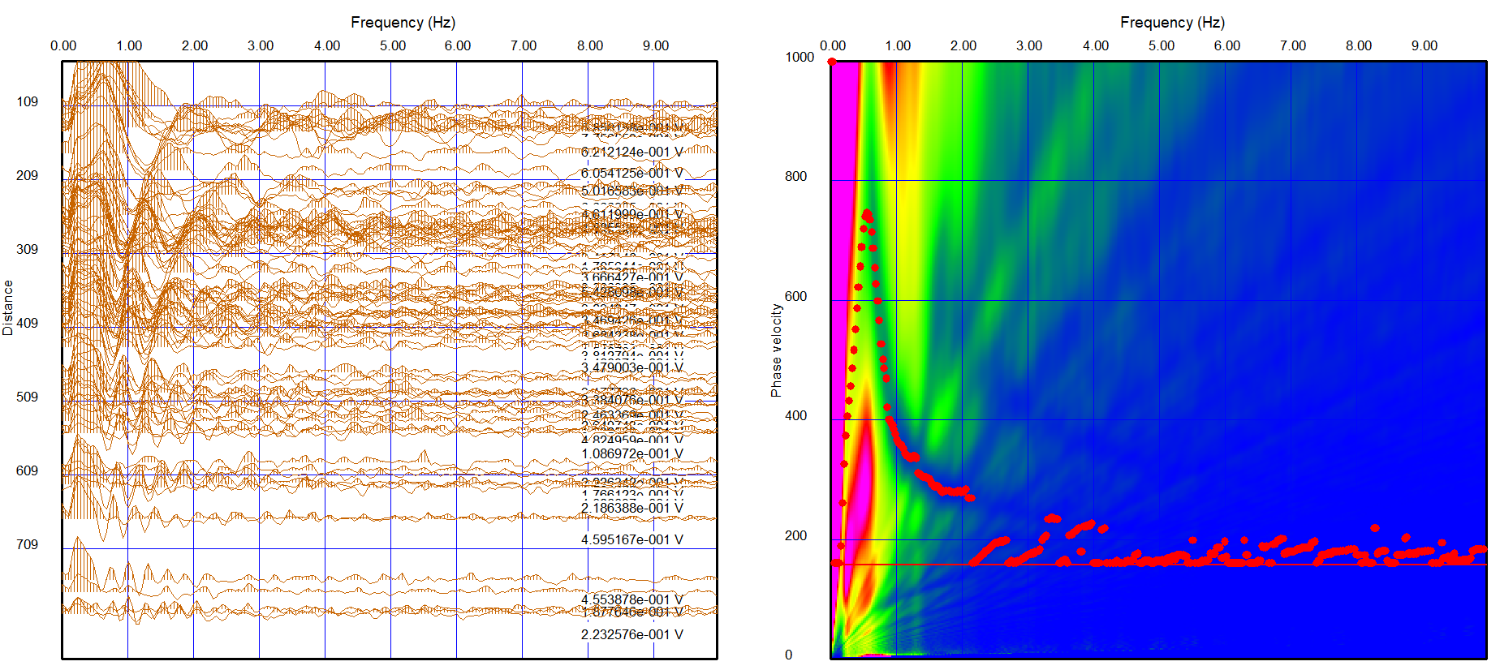
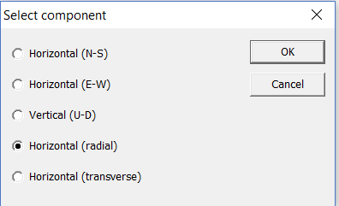
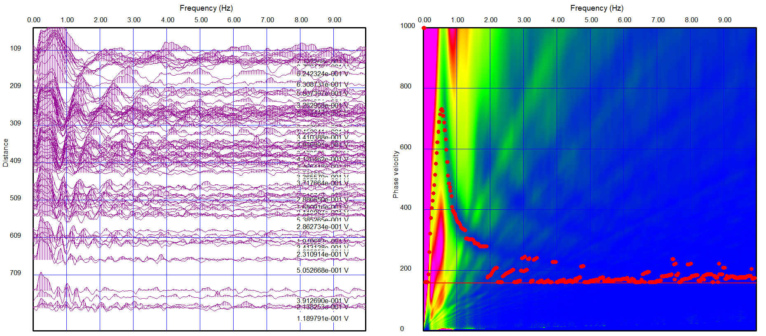
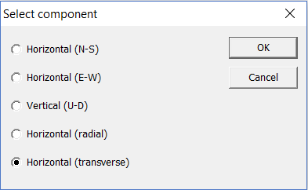
Repeat SPAC calculation for all components
Radial component
Note that dispersion curves from transverse and radial components do not correspond to Love wave dispersion curve.
Transpose component

Slide 15
Switch Pickwin to the complete menu
Use the “Complete menu” to process 3C SPAC data.
Complete menu
Select “Option”, “Menu type”, “Simple” to the menu type from “Simple” to “Complete”.
Simple menu

Slide 16
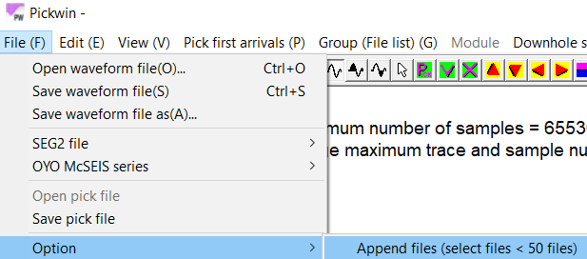
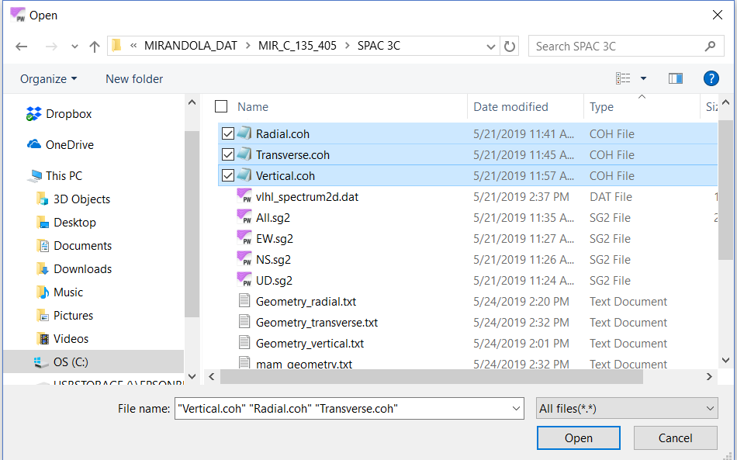
Import three SPAC files to Pickwin
Select “File”, “Option”, “Append files” to import multi files at once.
Select three coherency files (vertical, radial and transverse) and click “Open”.

Slide 17
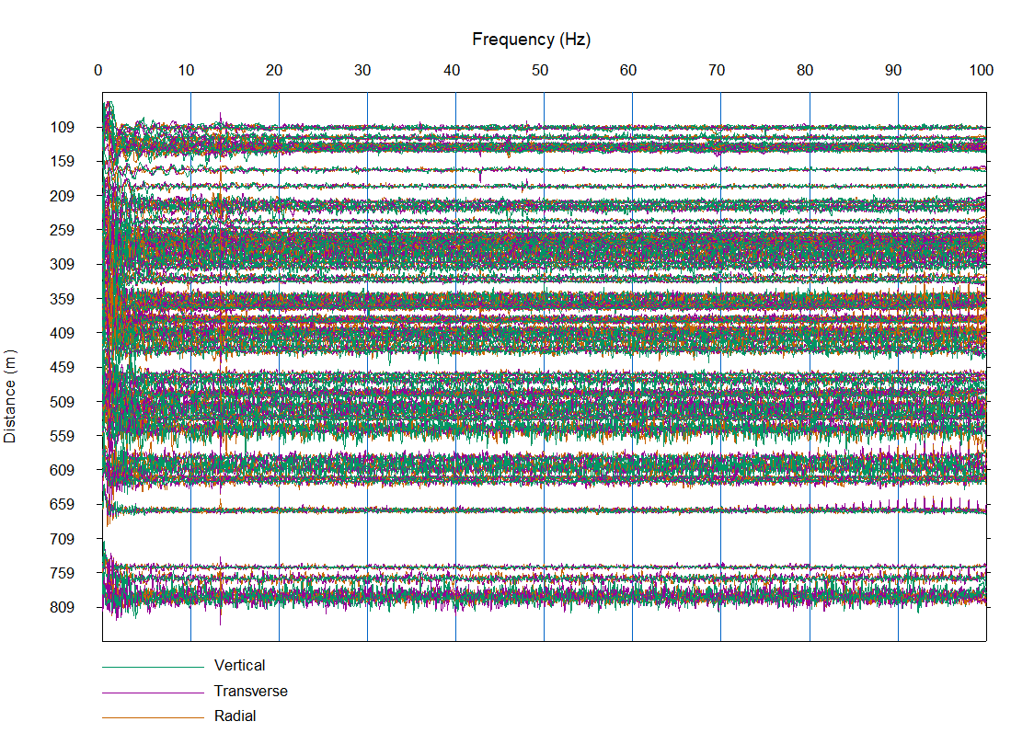
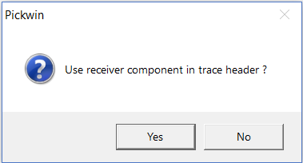
Import three SPAC files to Pickwin
Click “Yes” to continue.
Three component (vertical, radial and transverse) SPACs appear.

Slide 18
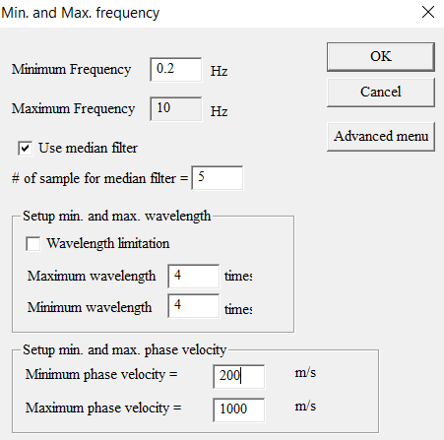
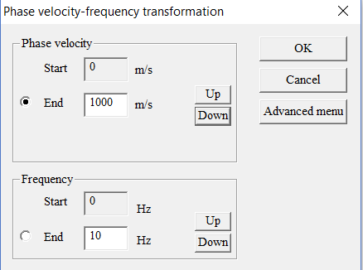
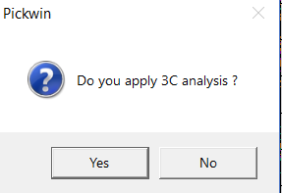
Calculate Rayleigh and Love phase velocity images
Click or press “Ctrl+D”
to calculate phase velocity images.
Set up transformation parameters as usual.
Click “Yes” to apply 3C SPAC analysis.

Slide 19
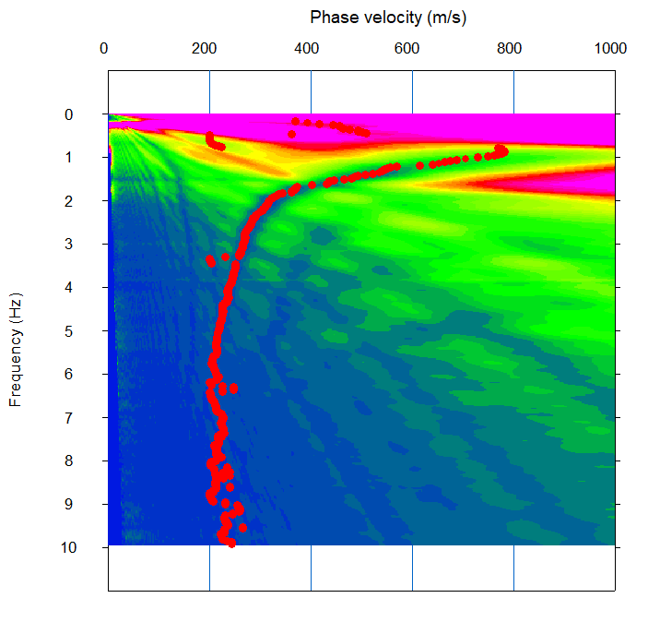
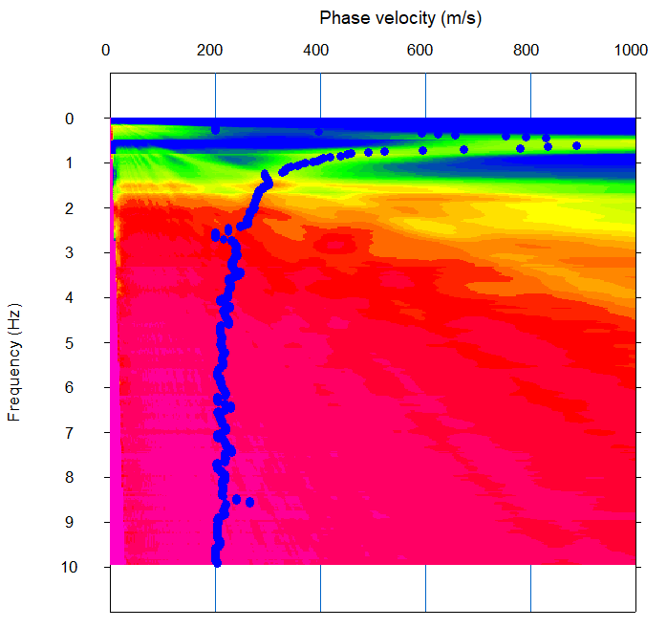
Calculate Rayleigh and Love phase velocity images
Ryleigh wave phase velocity image appears at first.
Click to switch Rayleigh/Love phase velocity images.
Rayleigh wave
Love wave
Note that the color scale of Love wave phase velocity image is opposite to Rayleigh wave.

Slide 20
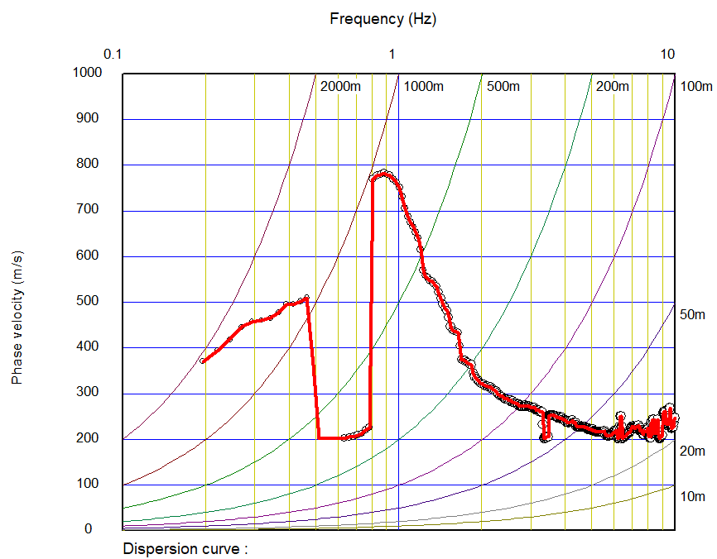
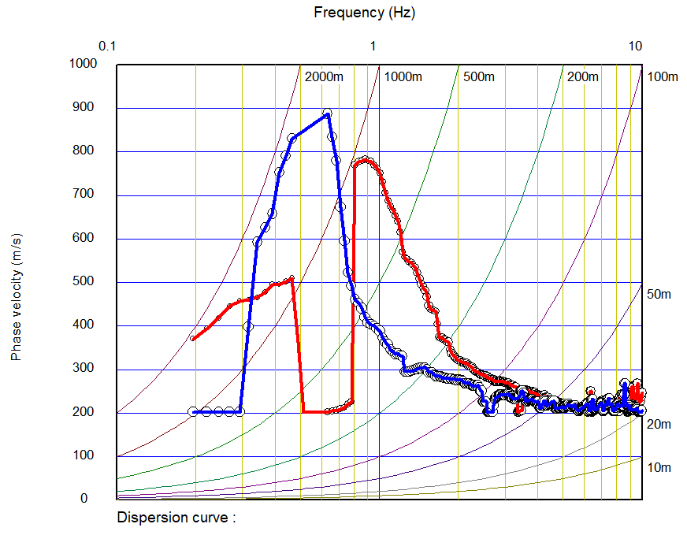
Show Rayleigh and Love dispersion curves by WaveEq
Click or select “Surface wave analysis”, “Show phase velocity curve (1D)” to show dispersion curves by WaveEq.
WaveEq launched and Rayleigh wave dispersion curve appears at first.
Click to show Love wave dispersion curve.
Rayleigh
Love

Slide 21
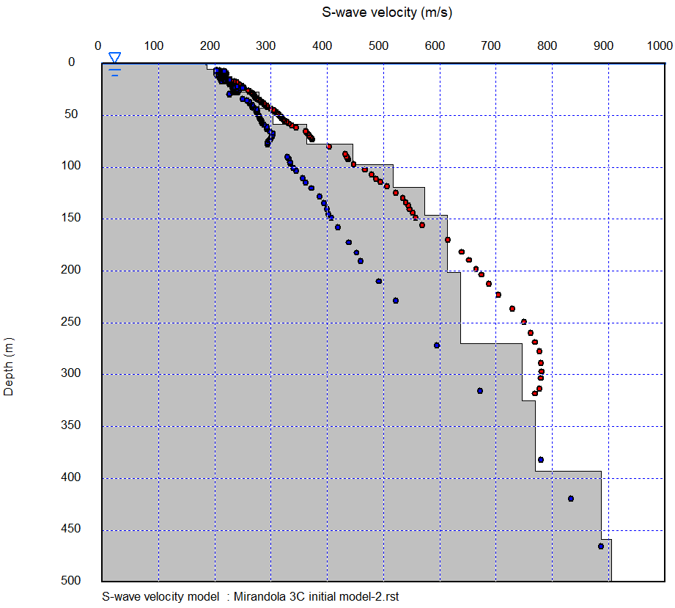
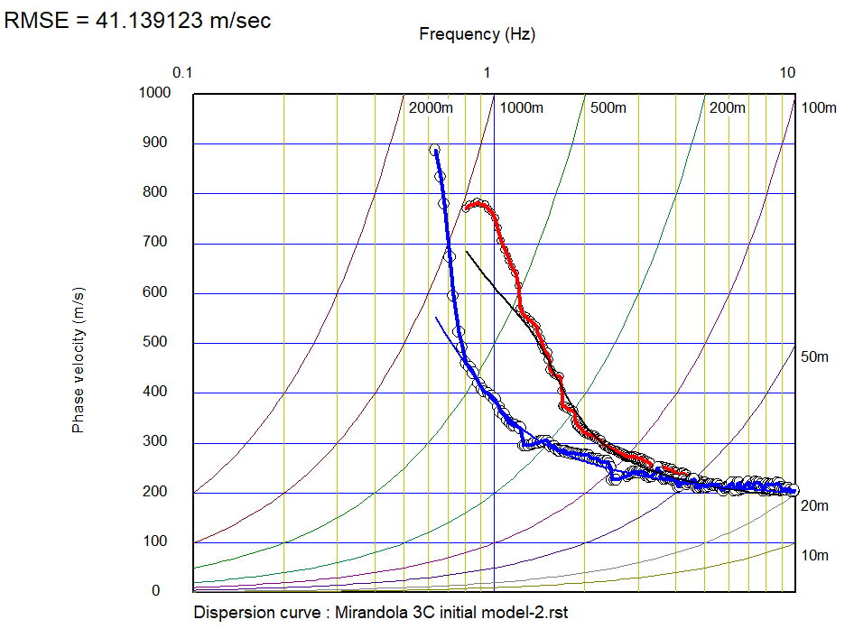
Edit dispersion curve and prepare an initial model
Edit dispersion curves and prepare an initial model as usual.
Comparison of observed and theoretical dispersion curves (fundamental mode).
Observed
Theoretical
Rayleigh
Love

Slide 22
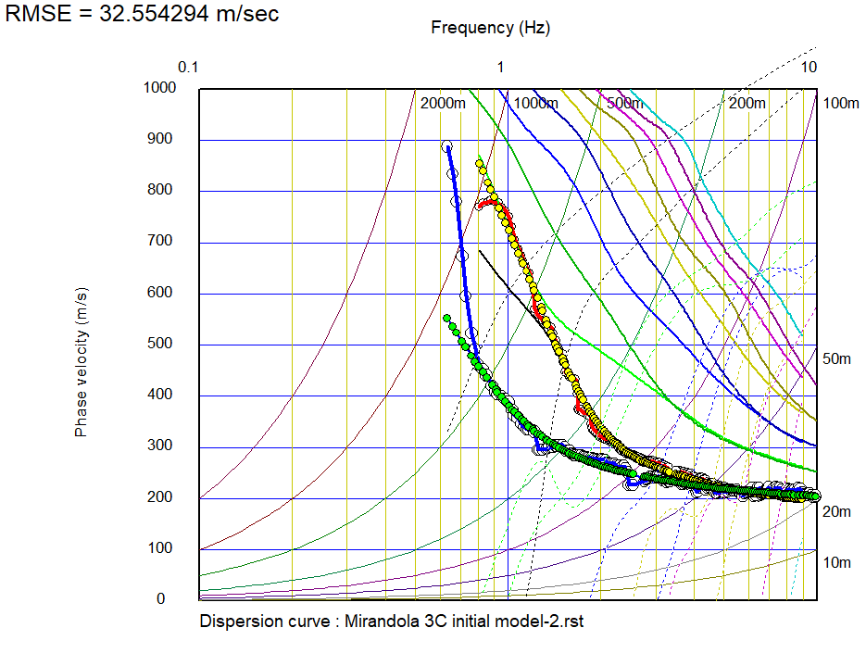
Comparison of observed and theoretical dispersion curves (Higher modes)
Rayleigh
Love
Velocity
Amplitude
Velocity
Amplitude
Observed
Averaged
(effective)
Fundamental
1st
2nd
3rd
4th
5th

Slide 23
Joint inversion of Rayleigh and Love waves
Joint inversion of Rayleigh and Love waves using non-linear least squares method or Genetic Algorithm (GA) were implemented in WaveEq.
Inversions are available in “Inversion (LSM)”, “GA (Vs only)” and “GA (Vs and thickness)” in “MASW/MAM (1D)” of WaveEq.

Slide 24
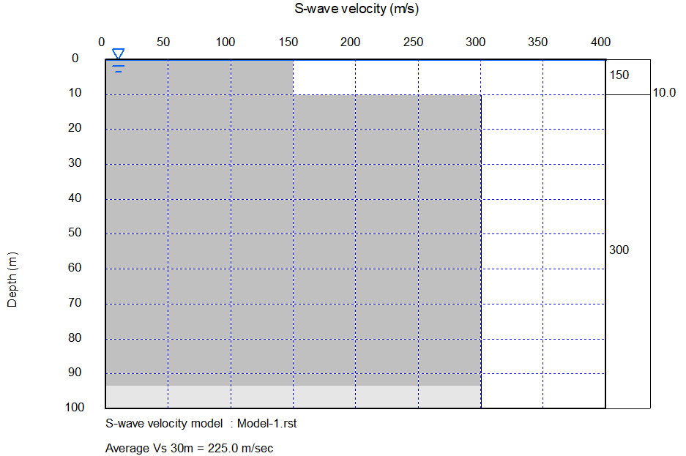
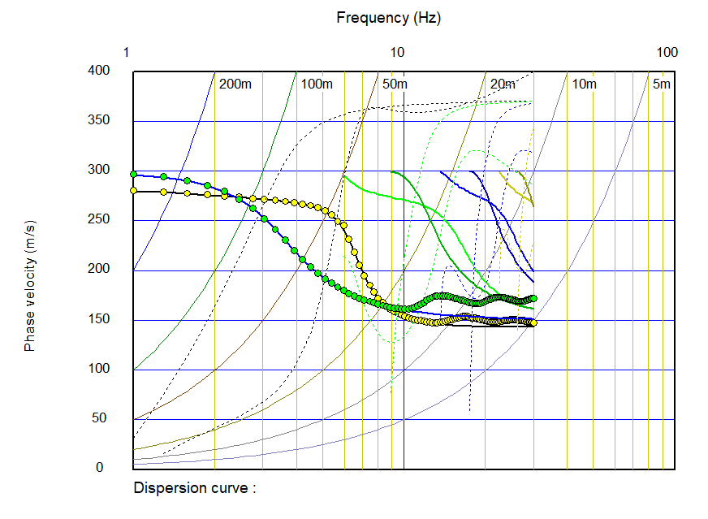
Joint inversion of Rayleigh and Love waves
Numerical example using two layer model
Theoretical velocity model for the true velocity model
True velocity model
Both Rayleigh and Love wave effective modes are different from fundamental modes.

Slide 25
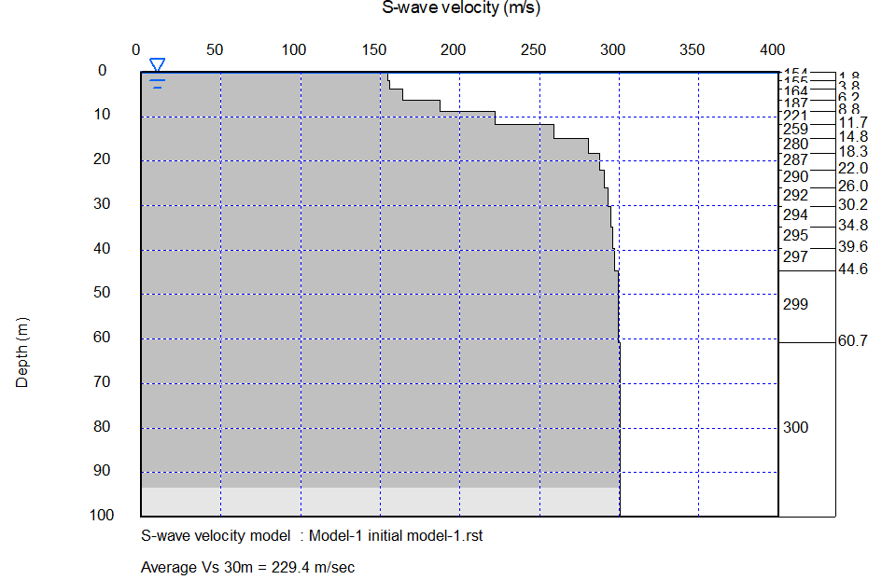
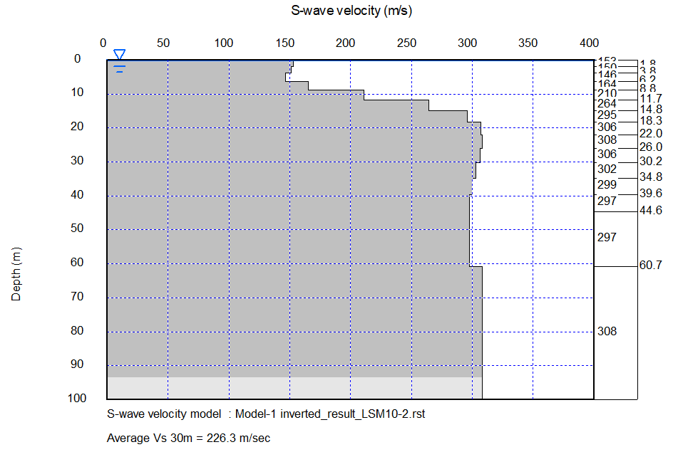
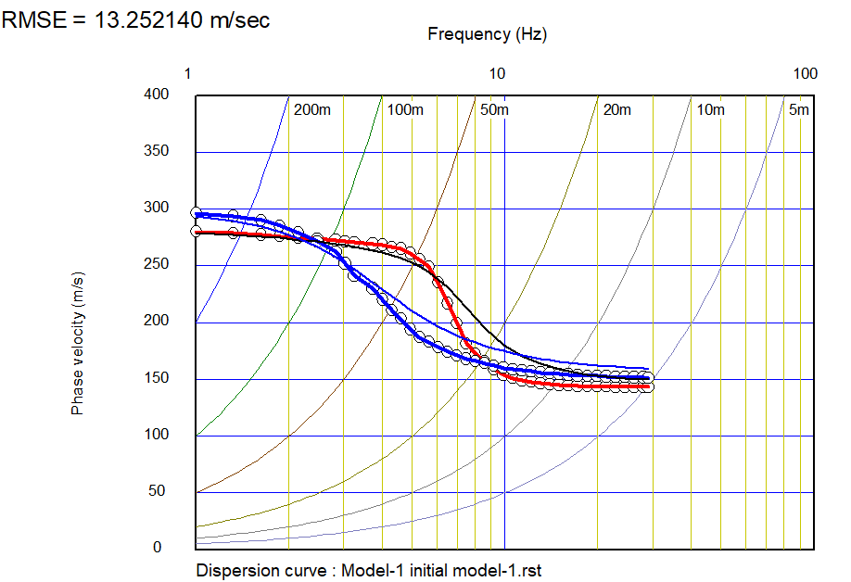
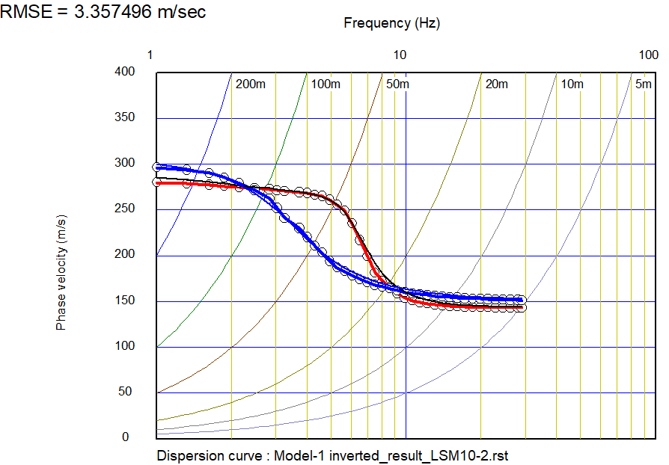
Joint inversion of Rayleigh and Love waves (only fundamental mode)
Initial model
Inverted result
Inversion using non-linear least squares method.
Inversion using non-linear least squares method decreased the error between observed and theoretical dispersion curves.

Slide 26
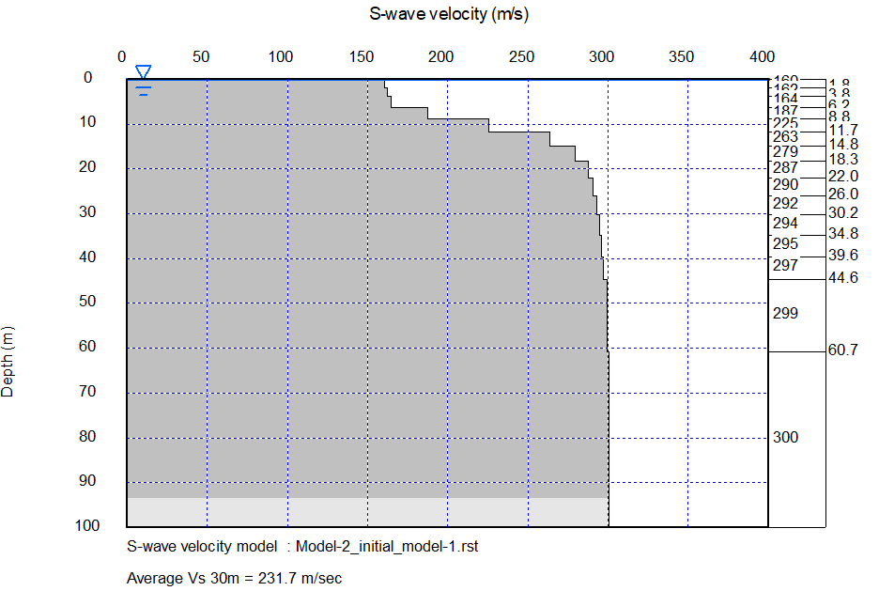
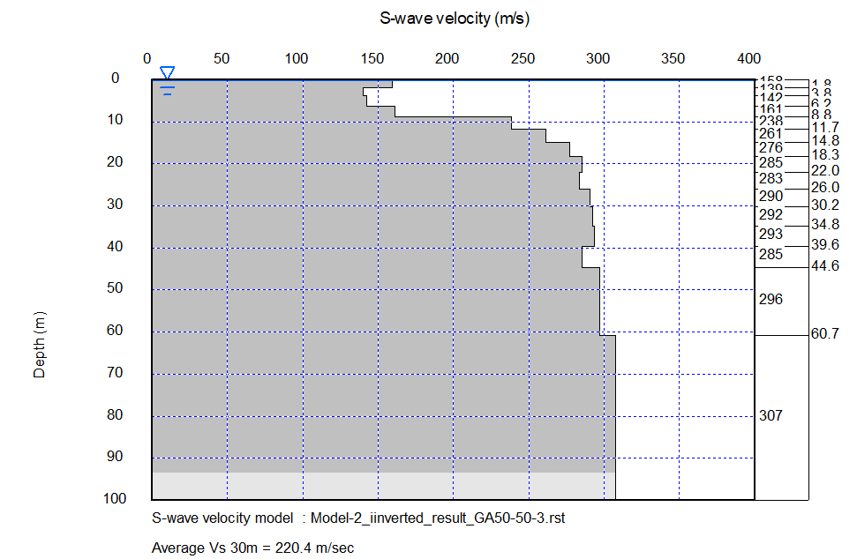
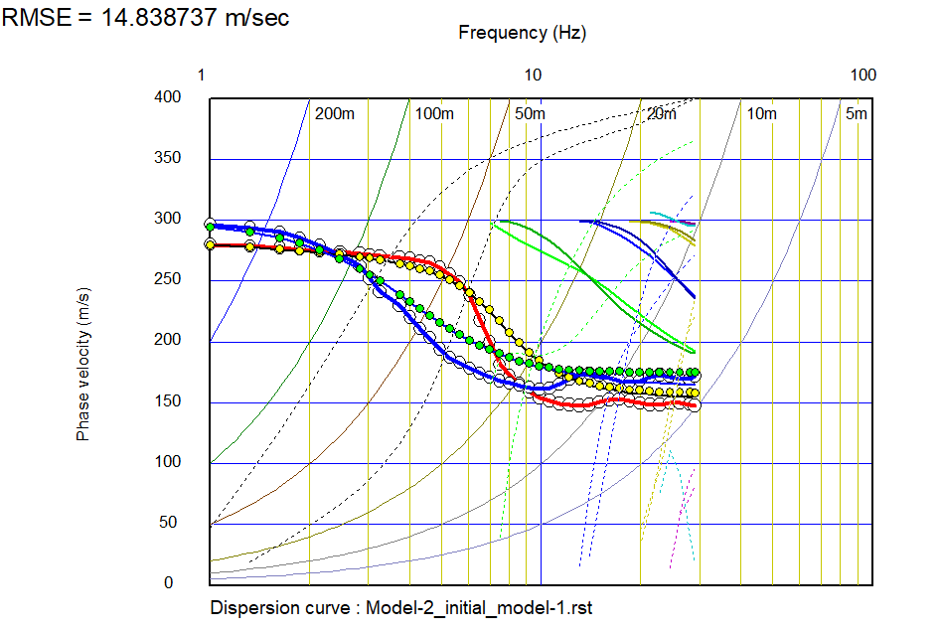
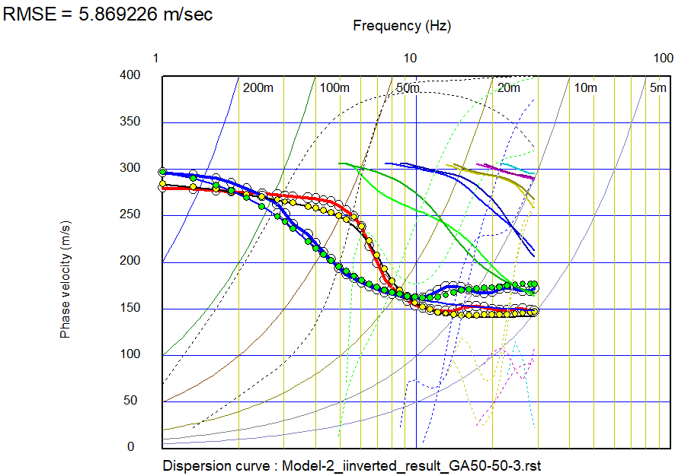
Joint inversion of Rayleigh and Love waves (including higher modes)
Initial model
Inverted result
Inversion using Genetic Algorithm (GA).
Inversion using GA decreased the error between observed and theoretical (effective mode) dispersion curves.

Slide 27
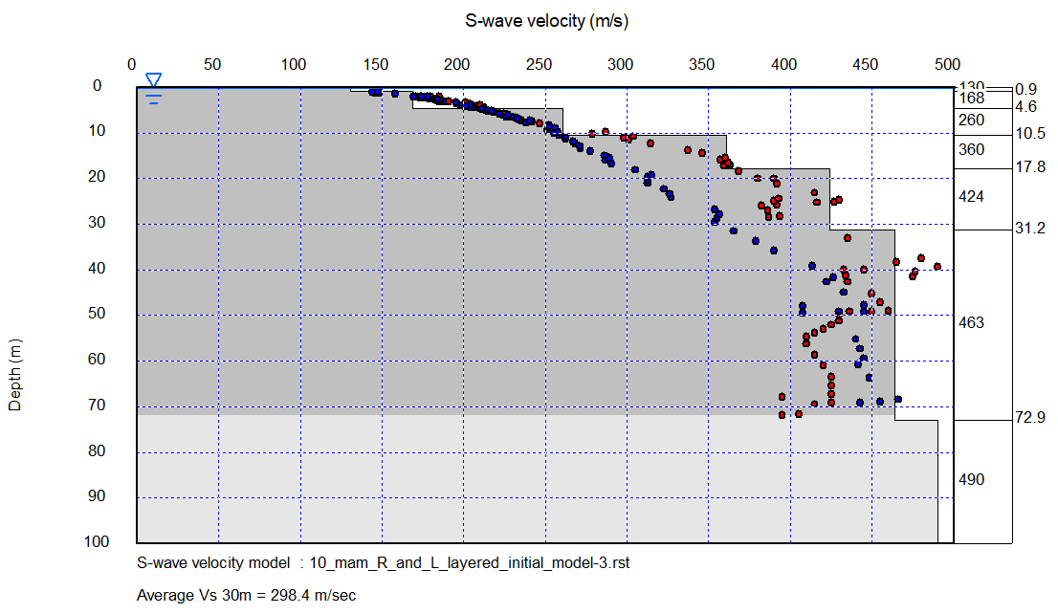
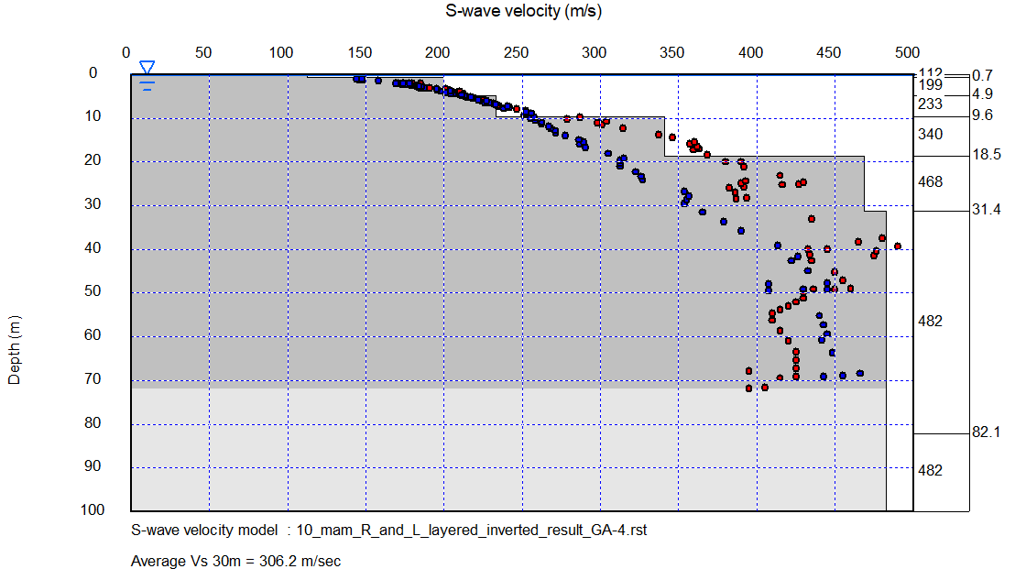
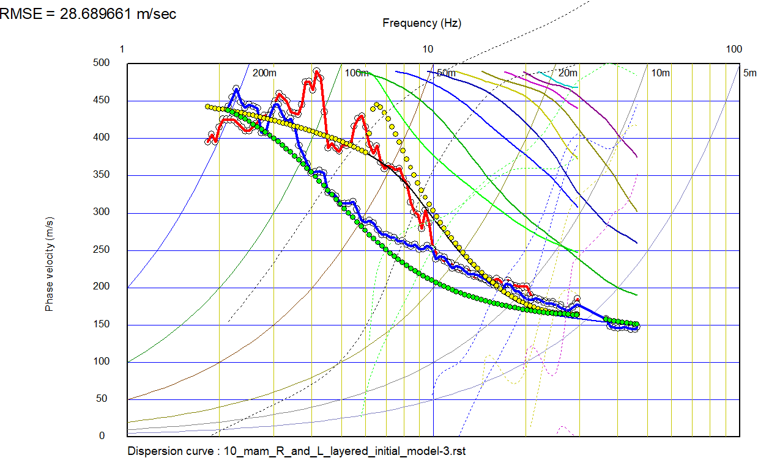
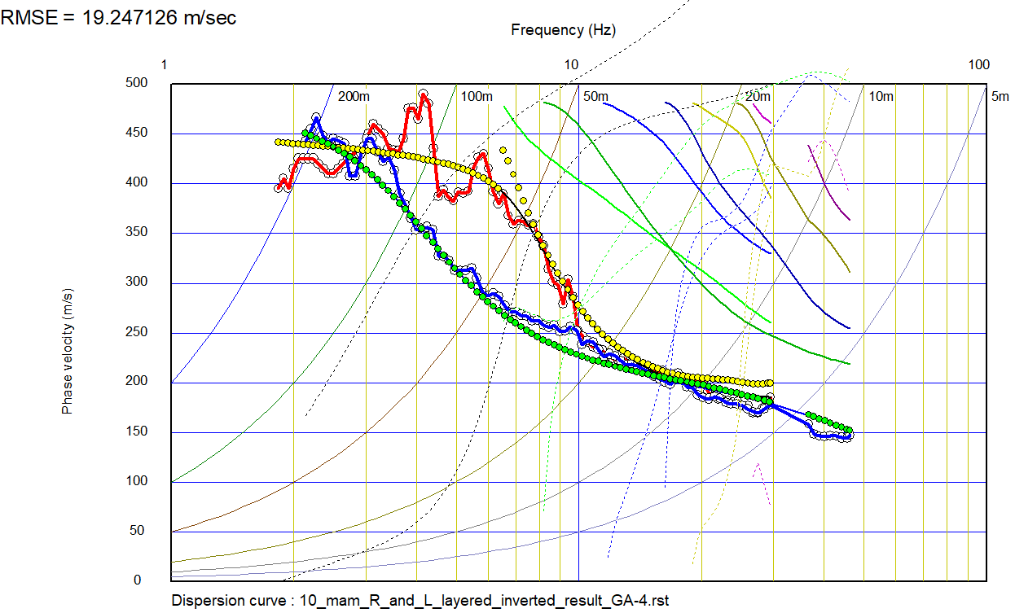
Joint inversion of Rayleigh and Love waves (including higher modes)
Field data example
Initial model
Inverted result
Inversion using Genetic Algorithm (GA).

Slide 28
Option : Use dispersion curve from transverse component as Love wave
Theoretically, phase velocities of transverse component is close to that of Love waves. You may consider dispersion curve of transverse component as that of Love waves. In active methods, dispersion curves obtained from SH measurements can be considered as the dispersion curves of Love waves.
3C spatial autocorrelation
Rayleigh and Love wave dispersion curves
S-wave velocity model
Transverse (or SH measurement)
Love
Love wave .rst file
Vertical
(or P-Sv measurement)
Rayleigh
Rayleigh wave .rst file

Slide 29
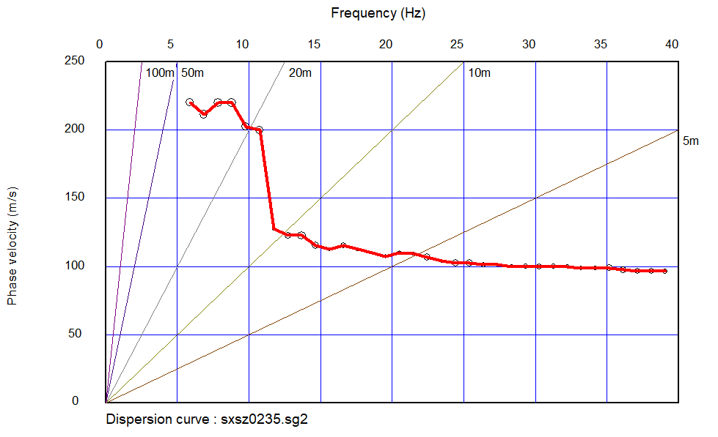
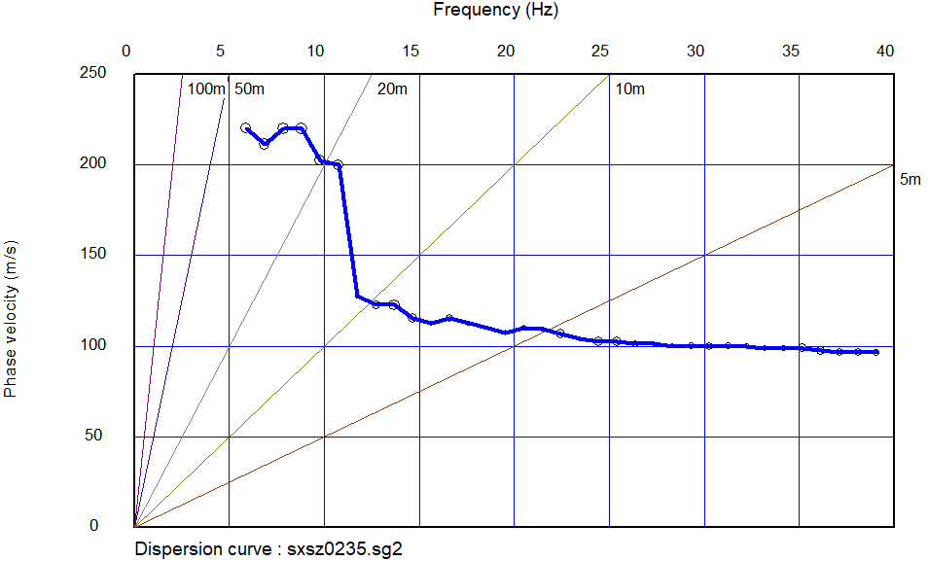
Option : Select Rayleigh or Love dispersion curve
You have a chance to select Rayleigh or Love dispersion curve
when launching WaveEq from Pickwin.
Rayleigh wave is shown as red
Love wave is shown as blue

Slide 30
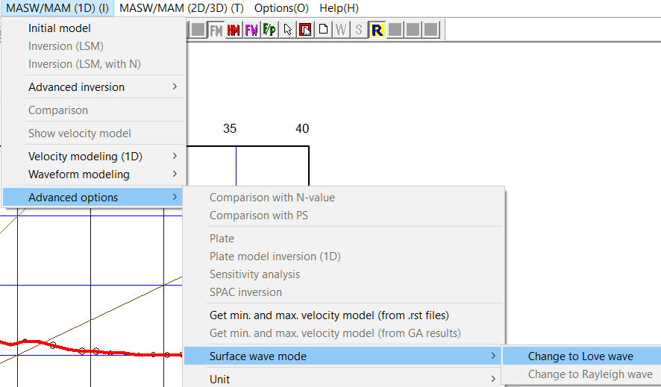
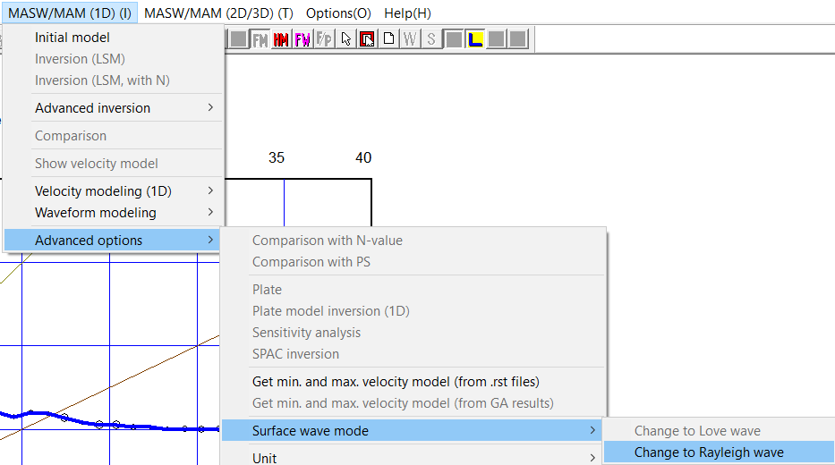
Option : Switch Rayleigh or Love dispersion curve
It is possible to switch (or select) Rayleigh or Love dispersion curve.
Use “MASW/MAM (1D)”, “Advanced option”, “Surface wave mode”.
Love wave is shown as blue
Rayleigh wave is shown as red

Slide 31
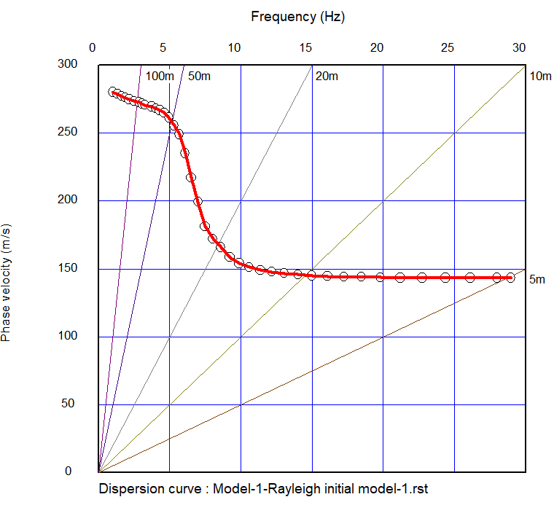
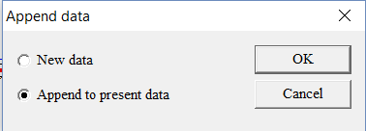
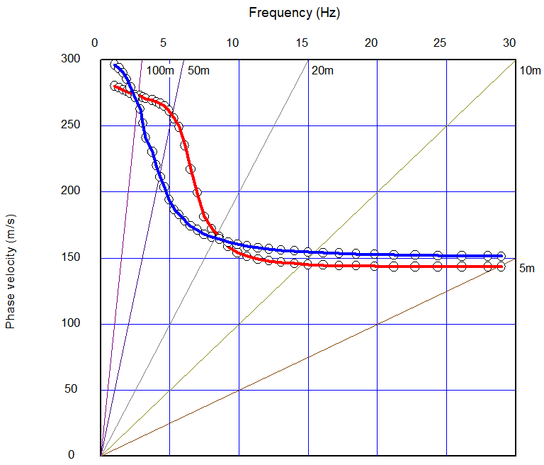
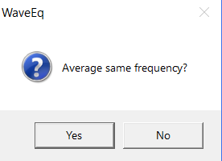
Option : Combine Rayleigh and Love dispersion curves
1) Save Rayleigh and Love wave dispersion curves to individual files.
5) Rayleigh and Love dispersion curves are shown together.
3) Open another (Love/ Rayleigh) file and append it.
2) Open one (Rayleigh/Love) file.
4) Select “Yes”.

